Slide 1

Project Team Builder
Intro
Dijkstra’s Dynamic Ducks
Matt Almenshad || TJ LaGrow || Kaiyu Song || Ryan Collier

Slide 2

Data Structure
Design
Input: CSV
Processing: CSV
Output: CSV
Full Name | Times Available
Full Name | Times Available | Potential Team 1 | Potential Team 2 | Potential Team 3 | Assigned Team
Full Name | Assigned Team

Slide 3



Pipeline
Design
Front End
Back End
User Interface
CSV
Team Matcher
CSV

Slide 4

MVP Features
Design
Viewing, Importing and exporting team information (Web UI)
Availability-based Grouping Algorithm (Back End)
Flexible team-editing (Web UI)

Slide 5

Ideal Features
Design
Common Programming Language Optimization (Back End)
Mass Group-Based Email Notifications (UI/Back End)
Like/Dislike Peer Rating Optimization (Back End)

Slide 6

Timeline
Design
Week 2
- Availability Grouping Algorithm
Week 3
- Reevaluate progress
Week 4
- Final Reevaluation
- Thoroughly test Beta
- Develop Interactive GUI
- Adjust where necessary
- Add additional features
- Final Presentation Prep

Slide 7
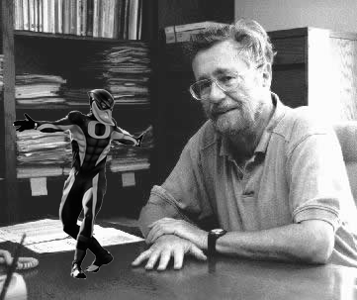
Dijkstra’s Dynamic Ducks
Thank You!
Conclusion

